Slide 1


Intro to Coding Interviews
By: Juan Peñuela

Slide 2
Why do they exist?
Problem solving skills are valuable, not just coding skills.
Some interviewers relate basic DSA knowledge with how well you can solve real-world problems at the workplace.
When candidates communicate their thought process to the interviewers, it is seen as a valuable skill.

Slide 3

How do Companies Select Their Questions?
The Truth: The only thing that makes a question “recent” on sites like LeetCode, is the fact that a random interviewer happened to pick it, as there is no set list of questions for a company; rather, each interviewer picks their own.
But… How do Interviewers assess my performance in coding questions?

Slide 4
It’s All Relative!
Interviewers evaluate candidate’s performance relative to each other. For this reason, is not a bad thing if you have a hard question, since every other applicant had it too.
In other words, your performance is not evaluated against the question you were given, but rather, against the average performance of other candidates who had the same question.

Slide 5
How to Prepare for Coding Interviews
Create BIG Projects
Build your resume and portfolio
Target companies based on your skills
Learn / Review DSA
Apply to Companies!
Do mock interviews with friends
Practice and Master Big O
Practice questions

Slide 6







What is the Best Language for a Coding Assessment / Interview?
NO

Slide 7
About Picking a Language
Well… Most interviewers aren’t picky about languages, they’re more interested in how well you solve the problems than how well you know a language.
Prevalence: Choose a relatively common language that you feel comfortable and understand (e.g. Python or Java)
Avoid languages that will make you do extra work (e.g. C, which forces you to deal with memory allocation)

Slide 8
Strategies to Solve Coding Problems
1. Listen
Pay close attention to any important information given by the problem; If it’s given, you need it.
2. Example
Look for any edge cases in the problem, often the cases given are too small.
3. Brute Force
Write down the first approach that comes to mind, we’ll optimize later.
4. Optimize
5. Walk Through
6. Code it! Test it!
Does your solution meet the BCR$^{1}$? If not, then there might be room for improvement.
Does your solution meet the BCR ^1 ? If not, then there might be room for improvement.
Explain to the interviewer what you just did, if you missed something, they might even give you a hint!
Run the test cases and compare the actual output to the expected, if you solved it!, Congrats! If not, go back to your code and try to fix it.
1. BCR (Best conceivable runtime) the theoretical lowest possible time complexity that an algorithm can achieve for solving a given problem. It serves as a benchmark for optimal efficiency.

Slide 9
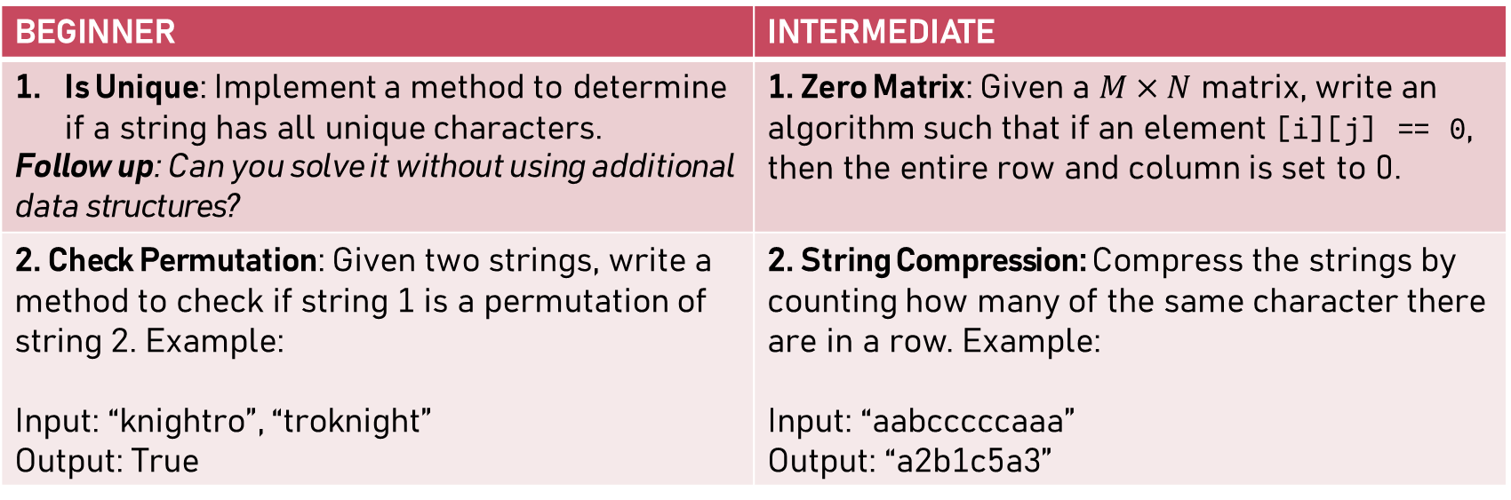
Let’s Try Some Questions!!!
BEGINNER | INTERMEDIATE
Is Unique: Implement a method to determine if a string has all unique characters. Follow up: Can you solve it without using additional data structures? | 1. Zero Matrix: Given a $M×N$ matrix, write an algorithm such that if an element [i][j] == 0, then the entire row and column is set to 0.
2. Check Permutation: Given two strings, write a method to check if string 1 is a permutation of string 2. Example: Input: “knightro”, “troknight” Output: True | 2. String Compression: Compress the strings by counting how many of the same character there are in a row. Example: Input: “aabcccccaaa” Output: “a2b1c5a3”

Slide 10
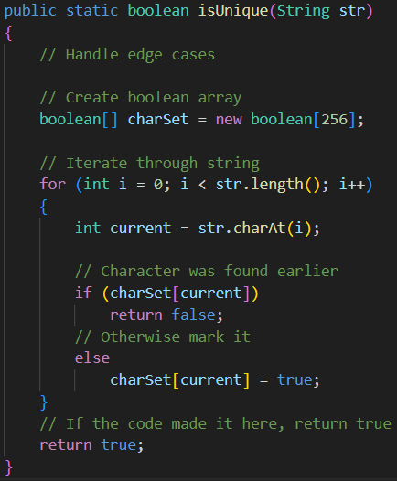

Beginner Solutions 1: Is Unique
One Option is to create an array of 256 Booleans (Due to ASCII characters), then iterate through the string, and for each character, mark that index as true. If the flag was already true, then return false.
If we can’t use additional data structures, there’s other approaches we can use:
1. Compare each character against each other $O\left(n^{2}\right)$
2. Sort the string and check neighboring characters.

Slide 11
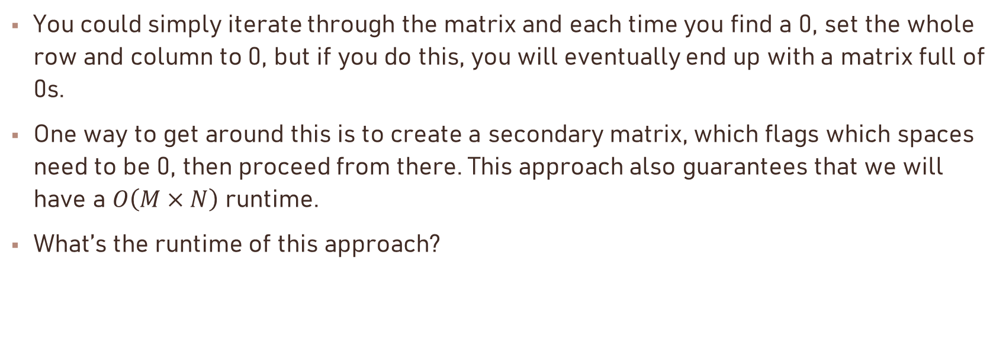
Intermediate Solutions 1: Zero Matrix
You could simply iterate through the matrix and each time you find a 0, set the whole row and column to 0, but if you do this, you will eventually end up with a matrix full of 0s.
One way to get around this is to create a secondary matrix, which flags which spaces need to be 0, then proceed from there. This approach also guarantees that we will have a $O\left(M×N\right)$ runtime.
What’s the runtime of this approach?

Slide 12
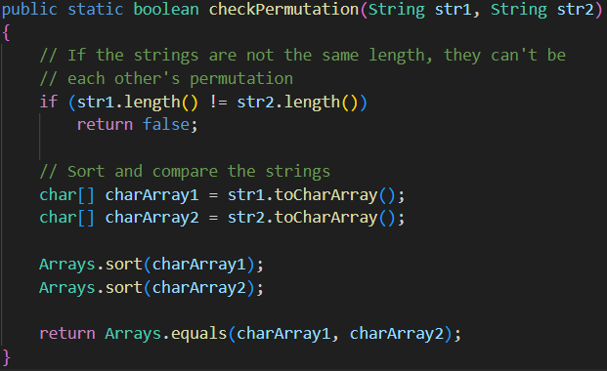
Beginner Solutions 2: Check Permutation
The easiest solution is to sort both strings, and if they match, then they are permutations of each other.
We can also check the character count on each string and see if they match, using a hash map or in python, the function Counter()
Follow up: What’s the BCR of this question?

Slide 13
Intermediate Solutions 2: String Compression
Option 1: Check if the current character is the same as the next character. If not, add its compressed version to the result. This works but is not efficient.
Option 2: Using a map to count the number of characters, then building the string based on the keys and values.
Option 3: Using a sliding window approach, where the fast pointer increases while the character remains the same; counting and building the string at the same time.
What other solutions did you come up with?

Slide 14

Let’s Connect!

Slide 15
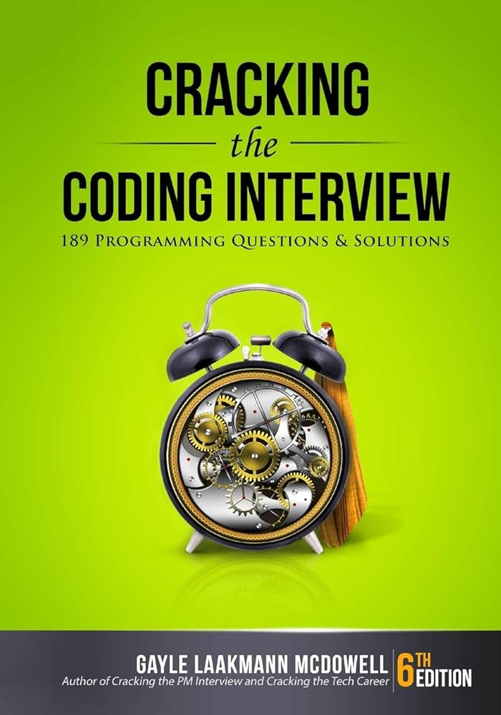
References
McDowell, Gayle Laakmann. Cracking the Coding Interview: 189 Programming Questions and Solutions. 6th ed., CareerCup, 2015.

